Slide 1
FLORAL FANTASY
FLOWER DECOR

Slide 2
REQURIMENT SPECIFICATION
The home page should be created with section ,graphics and suitable logo.
Home page should contain details of different flower with suitable logo.
Brief introductions to various floral themes and decorations ,Location information for the shop.
Present product information in two ways:
(a) By category (e.g., “Birthdays,” “Anniversaries,” “Weddings”)
(b)By specific flower type (e.g., “Rose decors”).
When user select any flower list of the brand will be display.
A brief summary individual product should be display and product detail word document which can be download.
The user should able to compare the product of different well as similar categories.
They create contact us page address of the company and location geo location and mail address should be clickable the local client from they can send an email.

Slide 3
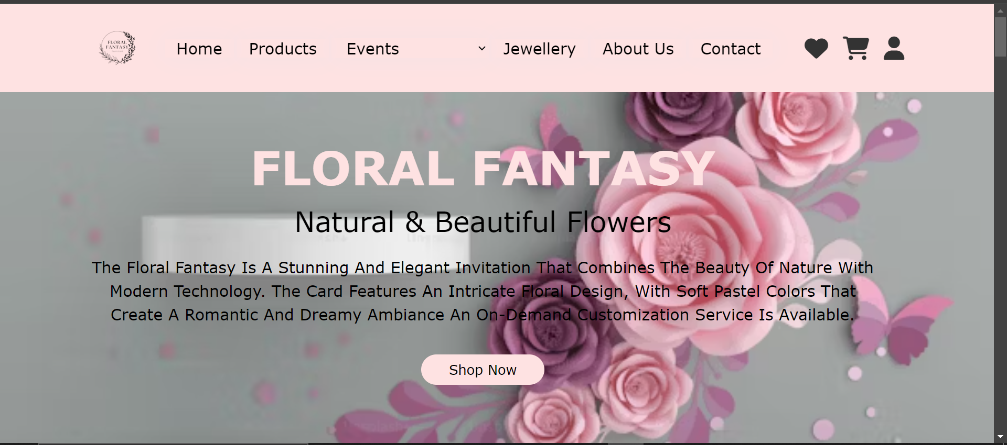
The home page should be created with section ,graphics and suitable logo.

Slide 4
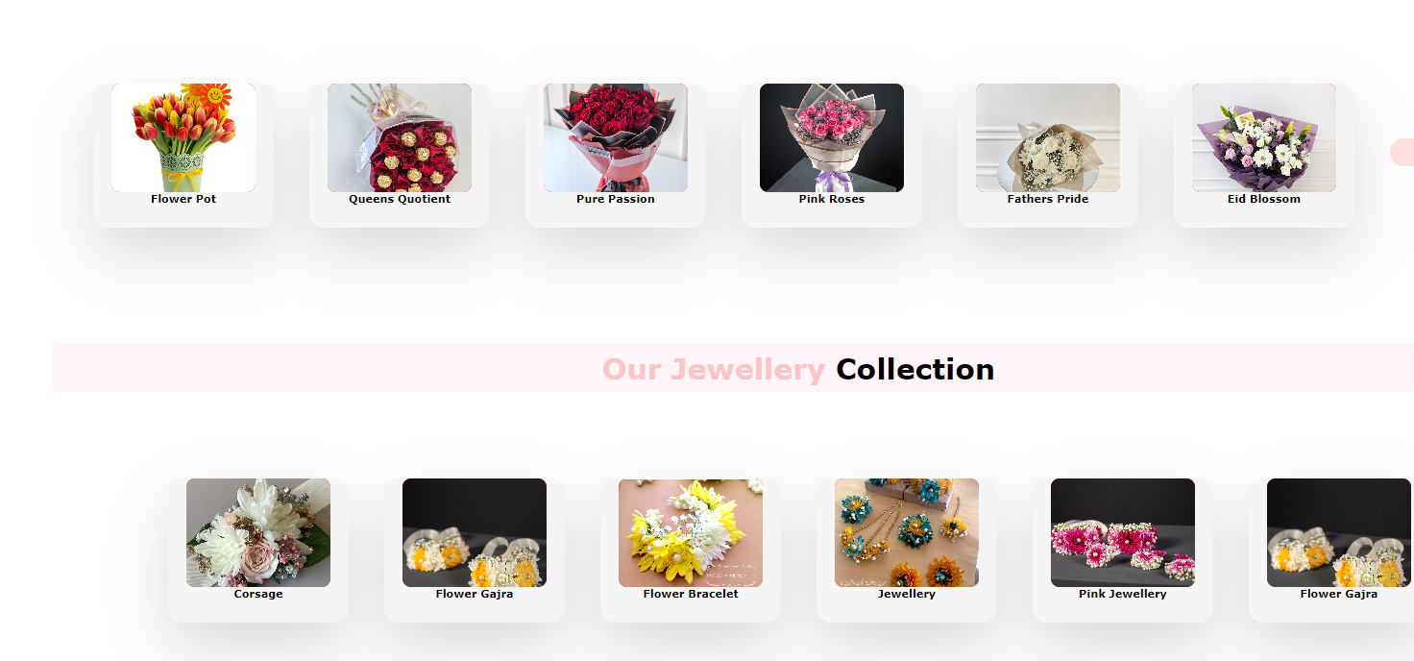
2. Home page should contain details of different flower with suitable logo.

Slide 5
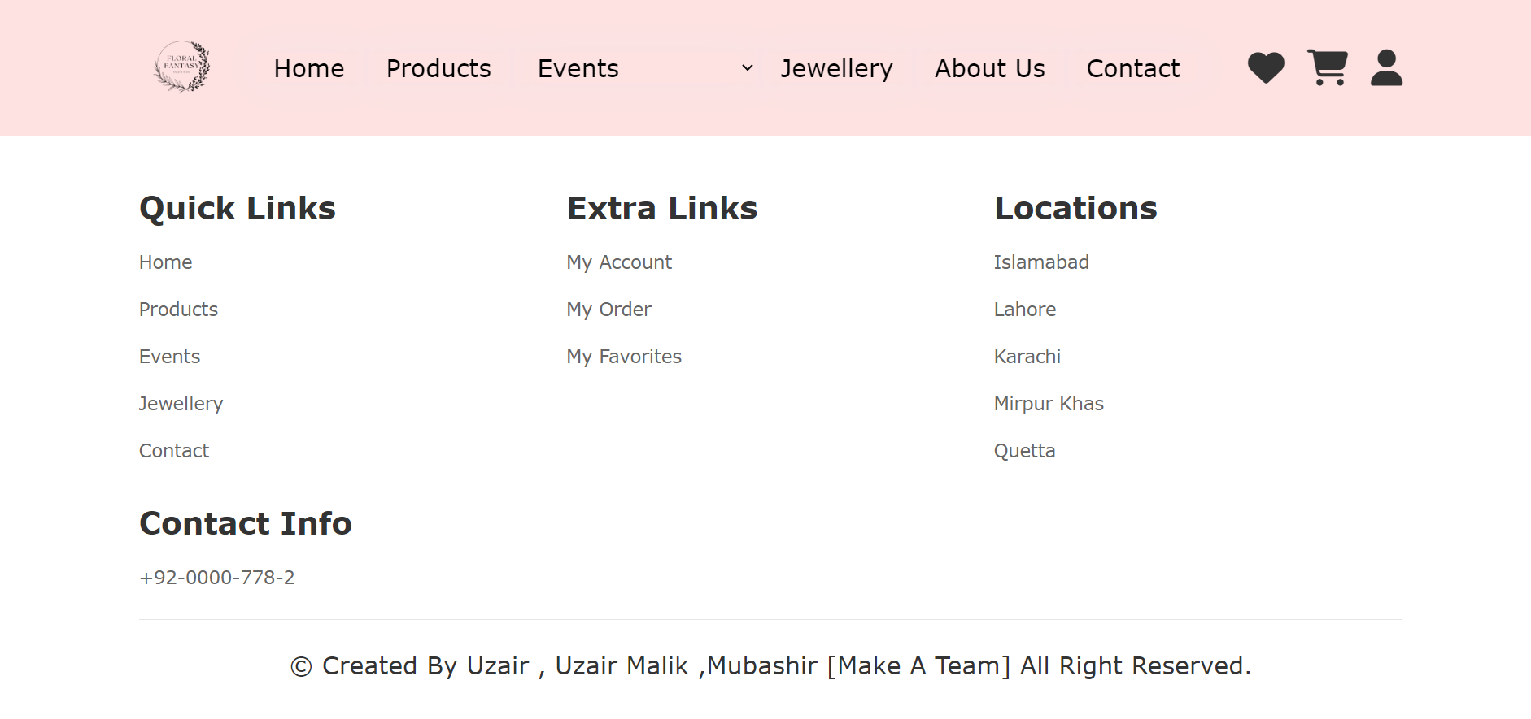
Brief introductions to various floral themes and decorations ,Location information for the shop
Brief Introductions to Floral Themes and Decorations:
We’ll create a section on the home page that provides concise descriptions of various floral themes and decoration styles. Users can learn about the significance, symbolism, and aesthetics associated with different flowers.

Slide 6
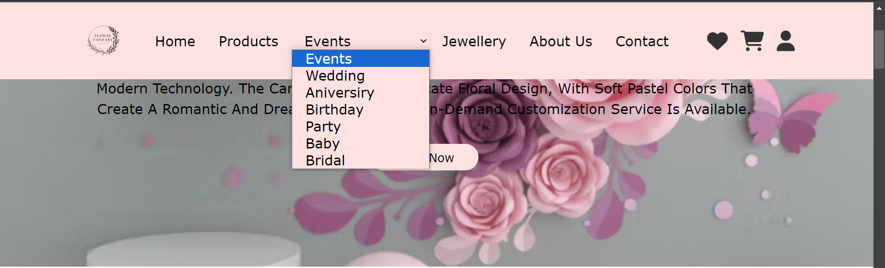
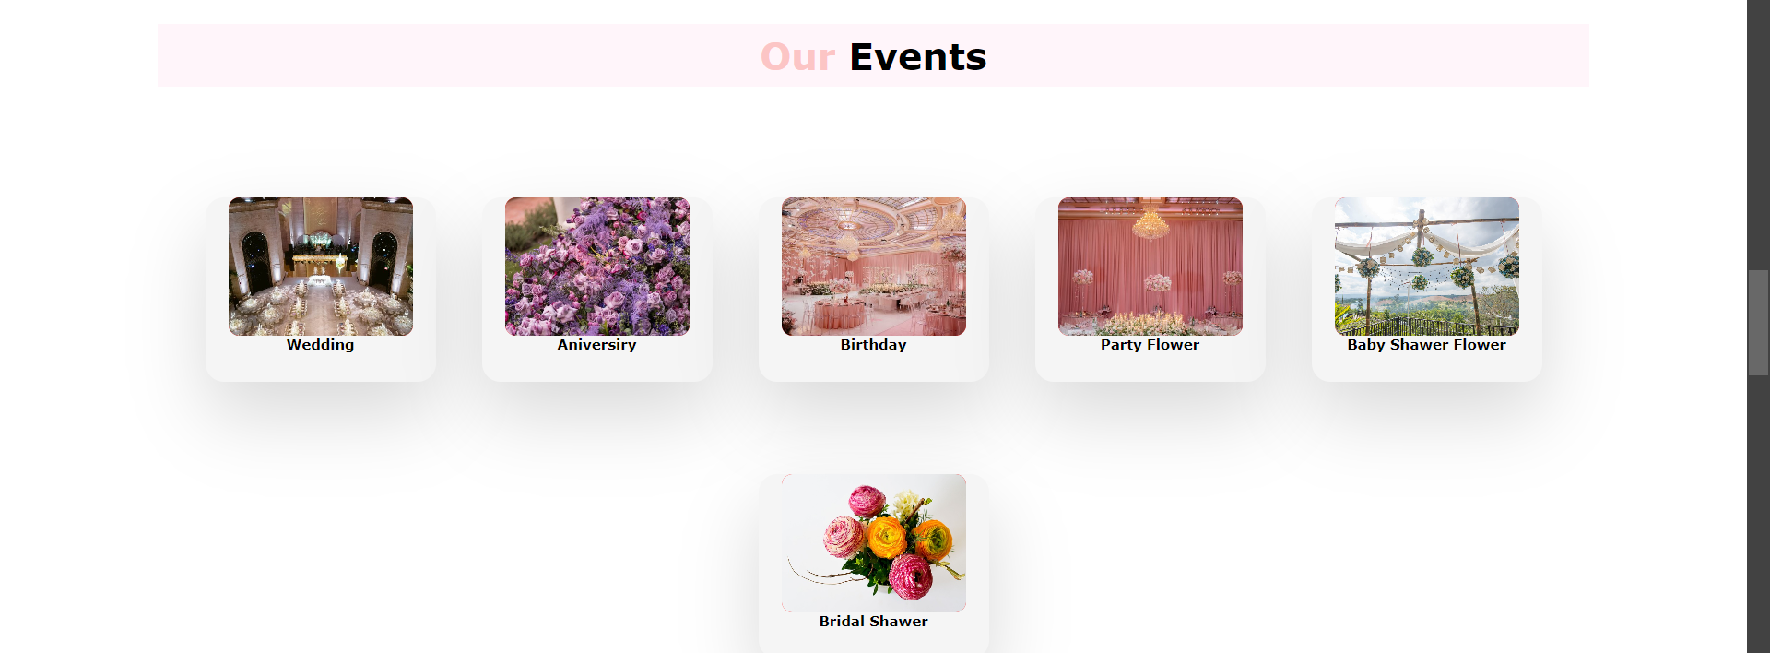
4. Present product information in two ways: (a) By category (e.g., “Birthdays,” “Anniversaries,” “Weddings”) (b)By specific flower type (e.g., “Rose decors”).

Slide 7
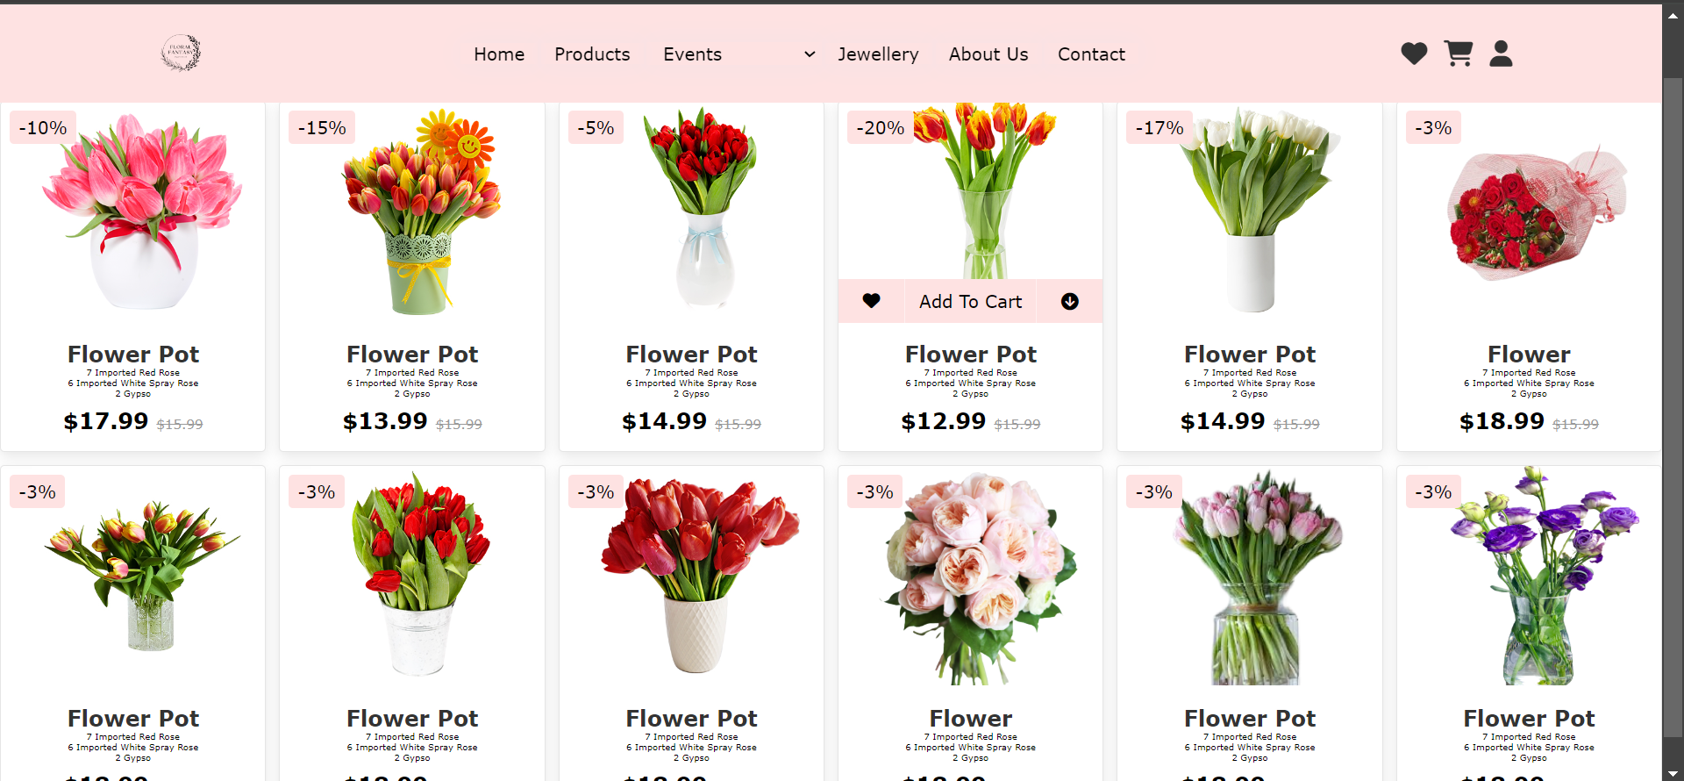
5. When user select any flower list of the brand will be display.

Slide 8
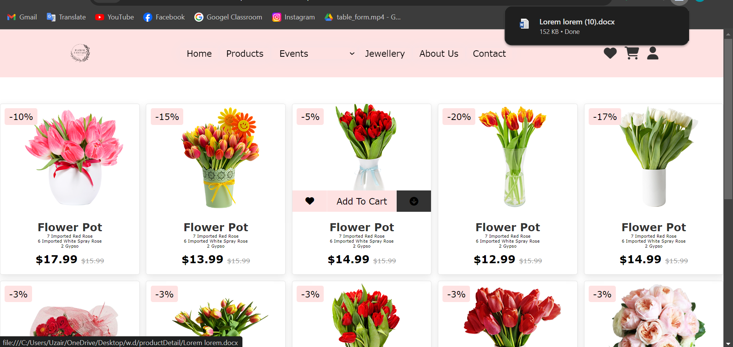
6. A brief summary individual product should be display and product detail word document which can be download.

Slide 9
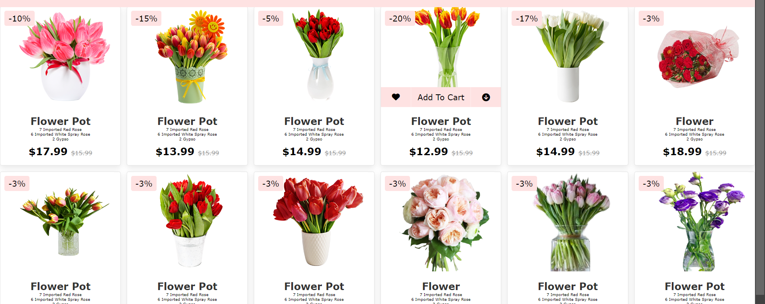
The user should able to compare the product of different well as similar categories.

Slide 10
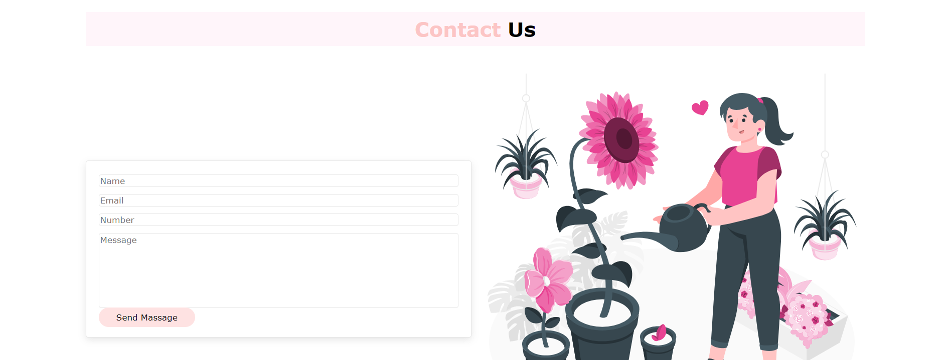
They create contact us page address of the company and location geo location and mail address should be clickable the local client from they can send an email.

Slide 11
THANK YOU
index.html

